Slide 1
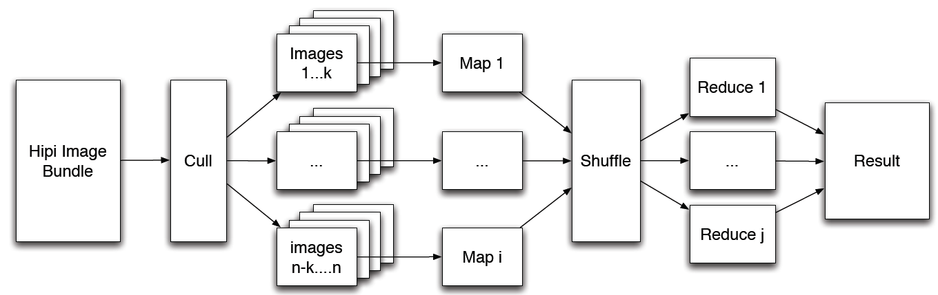
HIPI
Image Processing by using MapReduce
Above diagram shows the organization of a typical MapReduce/HIPI program

Slide 2
Hadoop Image Processing Interface
Scenario : Keeping the image files in HDFS and further processing to find its details like Camera details, Height and Width etc. for each image in a folder

Slide 3
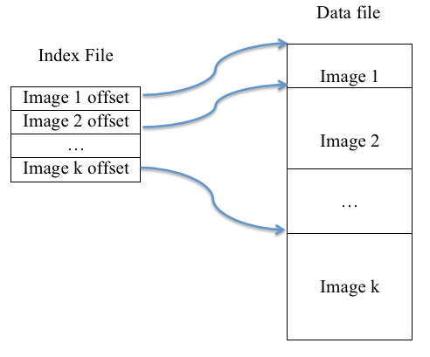
Hipi Image Bundle (Folder)
Created a HipiImageBundle(HIB) from a folder of images on our local file system. A HIB is the key input file to the HIPI framework and represents a collection of images stored on the Hadoop Distributed File System (HDFS).
Images are stored in .hib and .dat extension file in Hadoop Distributed File System (HDFS)

Slide 4
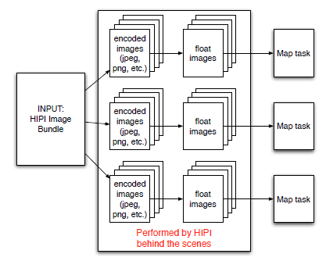
Our Created program has processed data from HIB data/images as mentioned in below diagram
We only need to specify a HIPI Image Bundle as an input, and HIPI will take care of parallelizing the task and sending float images to the mappers.
Using the HIPI Image Bundle data type as inputs, we have created an input specification that will distribute images in the HIPI Image Bundle across all map nodes

